Slide 1
Coding Dojo
Test Drive Development

Slide 2


Kent Beck did it
Origin
1989 sUnit
2000 Junit
2000 Extreme Programming
2001 Agile Manifesto
2002 Test Driven Development: By Example

Slide 3
Did he really?
Origin
Today a usual technique is to make a program and then to test it. But: program testing can be a very effective way to show the presence of bugs, but is hopelessly inadequate for showing their absence. The only effective way to raise the confidence level of a program significantly is to give a convincing proof of its correctness.
But one should not first make the program and then prove its correctness, because then the requirement of providing the proof would only increase the poor programmer’s burden. On the contrary: the programmer should let correctness proof and program grow hand in hand. […]
If one first asks oneself what the structure of a convincing proof would be and, having found this, then constructs a program satisfying this proof’s requirements, then these correctness concerns turn out to be a very effective heuristic guidance.
The Humble Programmer, Edsger W. Dijkstra, 1972

Slide 4
Even older?
Origin
A software system can best be designed if the testing is interlaced with the designing instead of being used after the design. Through successive repetitions of this process of interlaced testing and design the model ultimately becomes the software system itself. I think that it is the key of the approach that has been suggested, that there is no such question as testing things after the fact with simulation models, but that in effect the testing and the replacement of simulations with modules that are deeper and more detailed goes on with the simulation model controlling, as it were, the place and order in which these things are done.
Report of The Nato Software Engineering Conference, 1968

Slide 5
Come on …
Origin
The first attack on the checkout problem may be made before coding is begun. In order to fully ascertain the accuracy of the answers, it is necessary to have a hand-calculated. check case with which to compare the answers which will later be calculated by the machine. This means that stored program machines are never used for a true one-shot problem. There must always be an element of iteration to make it pay. The hand calculations can be done at any point during programming. Frequently, however, computers are operated by computing experts to prepare the problems as a service for engineers or scientists. In these cases it is highly desirable that the “customer” prepare the check case, largely because logical errors and misunderstandings between the programmer and customer may be pointed out by such procedure. If the customer is to prepare the test solution is best for him to start well in advance of actual checkout, since for any sizable problem it will take several days or weeks to and calculate the test.
Digital Computer Programming D.D. McCracken, 1957

Slide 6
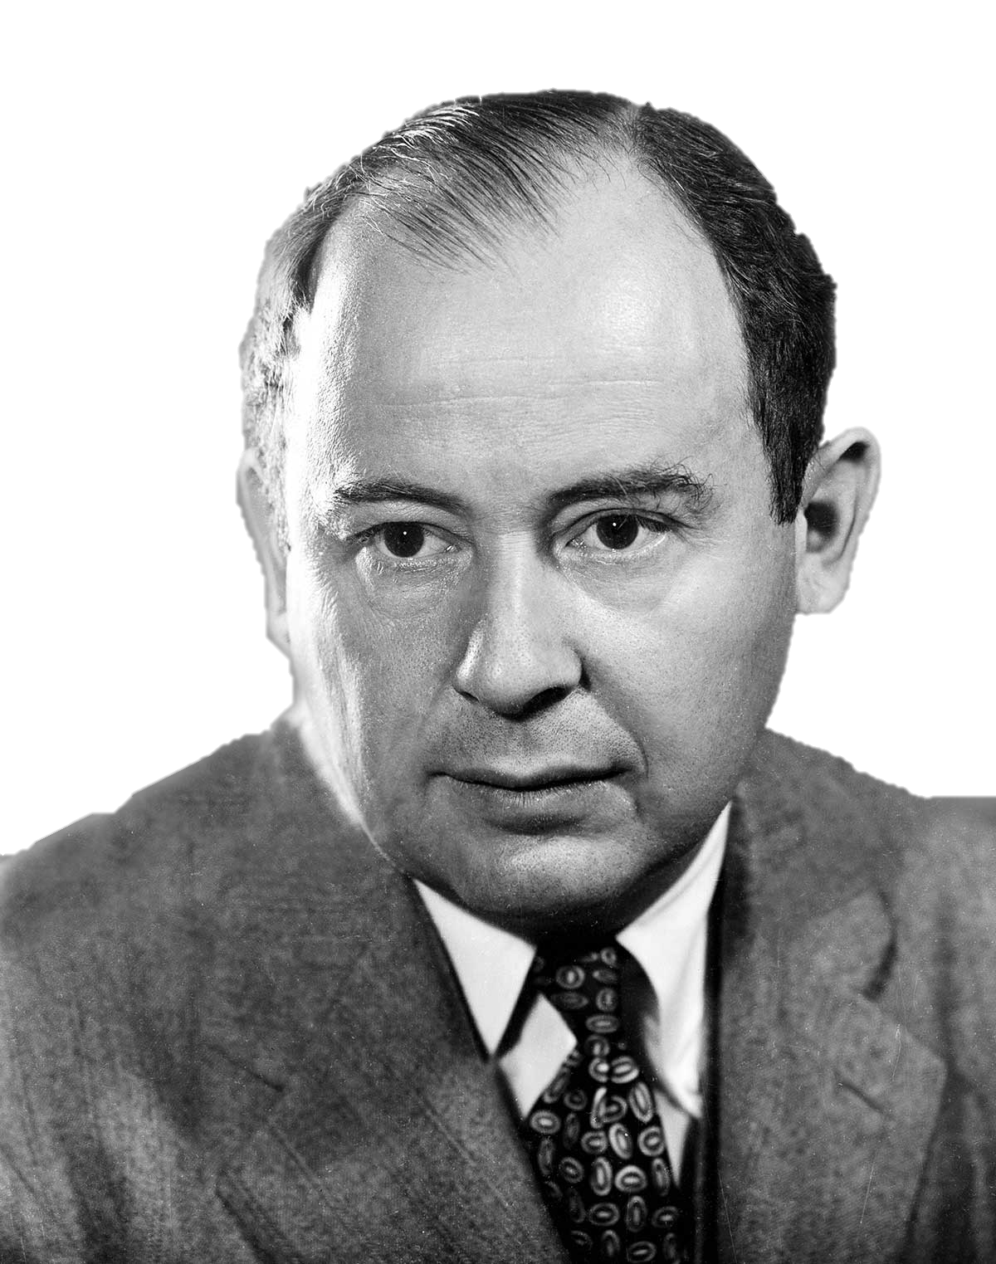
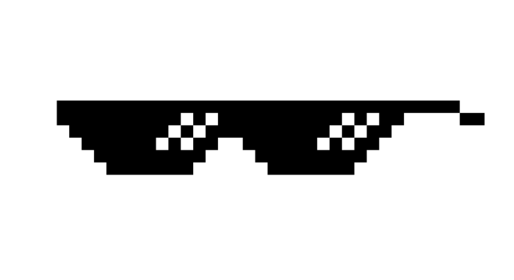
The real OG
Origin
Gerald M. Weinberg:
I learned it from Bernie Dimsdale, who learned it from von Neumann.
When I started in computing, I had nobody to teach me programming, so I read the manuals and taught myself. I thought I was pretty good, then I ran into Bernie (in 1957), who showed me how the really smart people did things. My ego was a bit shocked at first, but then I figured out that if von Neumann did things this way, I should.

Slide 7
The rediscoverer
Origin
Kent Beck:
The original description of TDD was in an ancient book about programming. It said you take the input tape, manually type in the output tape you expect, then program until the actual output tape matches the expected output.
After I’d written the first xUnit framework in Smalltalk I remembered reading this and tried it out. That was the origin of TDD for me. When describing TDD to older programmers, I often hear, “Of course. How else could you program?” Therefore I refer to my role as “rediscovering” TDD.

Slide 8
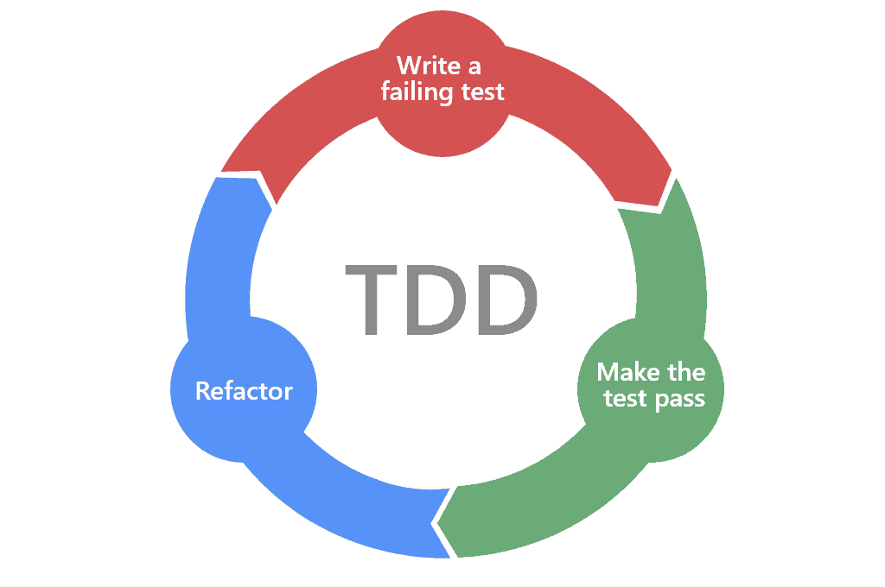
How to do it
Test driven development

Slide 9
What is it all about
Test driven development
TDD is about software design, drive design through tests
Tests are examples of usage
Software design is about where to put behavior
We only test behavior, not implementation details
Separate design of interface and implementation
We only add tests for new requirments

Slide 10
What is an interface or a module?
Test driven development
We need abstraction and modularization to develop software
Abstractions hide complexity
Modules split complex things into smaller parts
A module exports parts of itself to be used by others, this is its interface
An interface is an abstraction and makes modules e.g. replaceable
An interface is the meaning and semantics of exchanges between separate pieces of code
The system under test (SUT) in TDD is a module

Slide 11
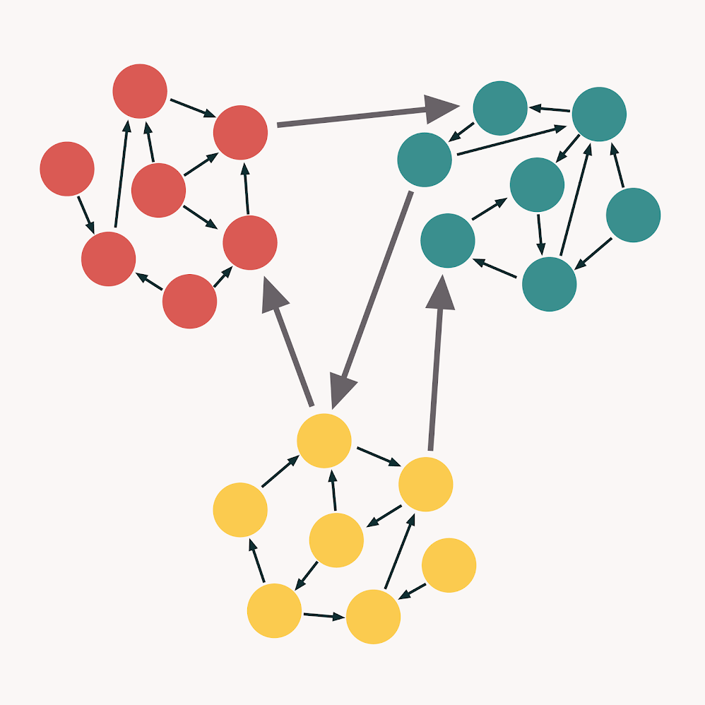
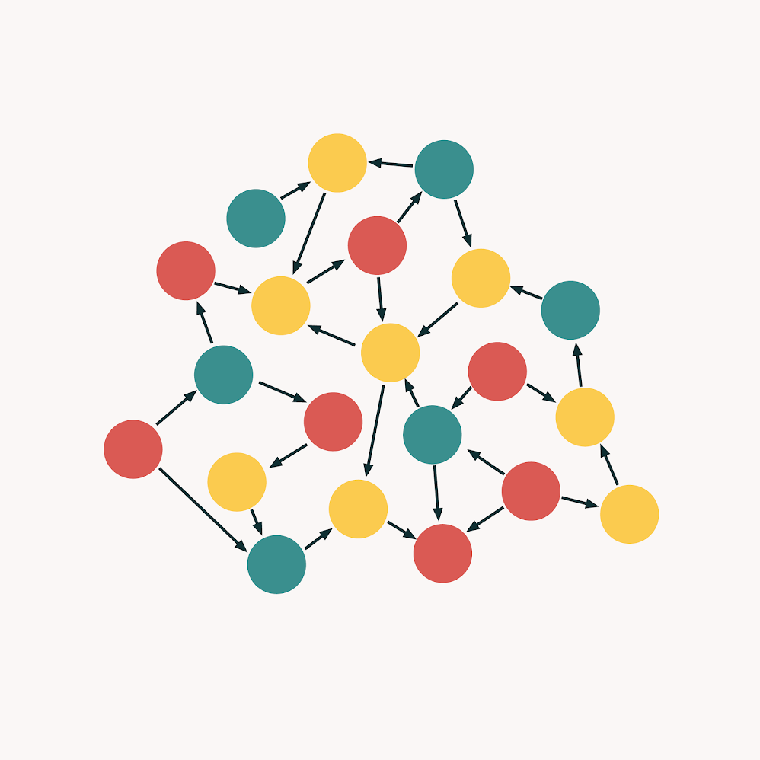
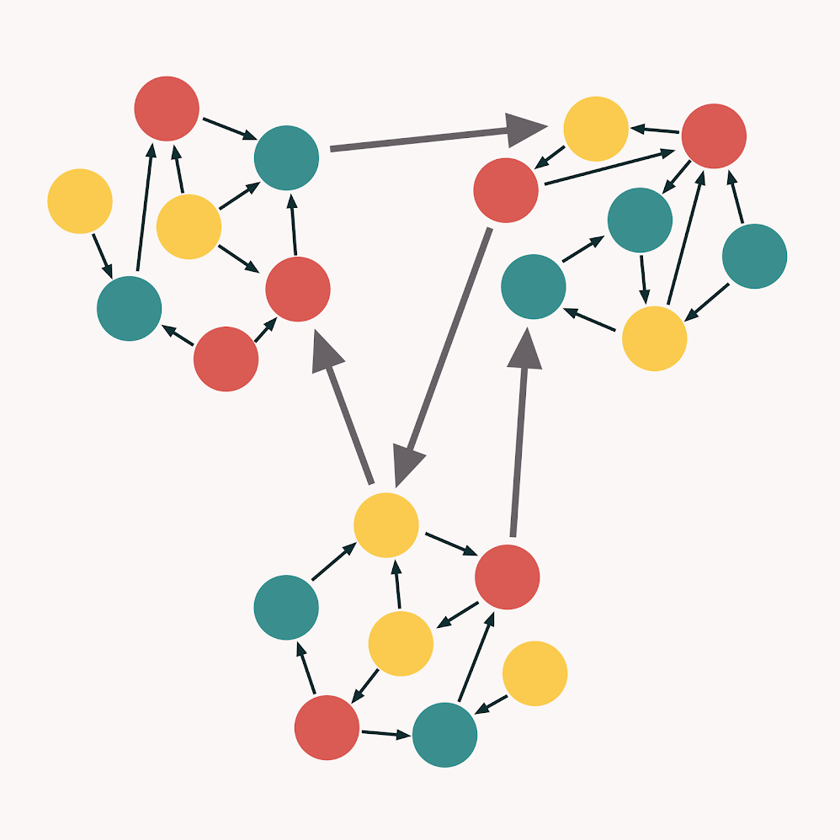
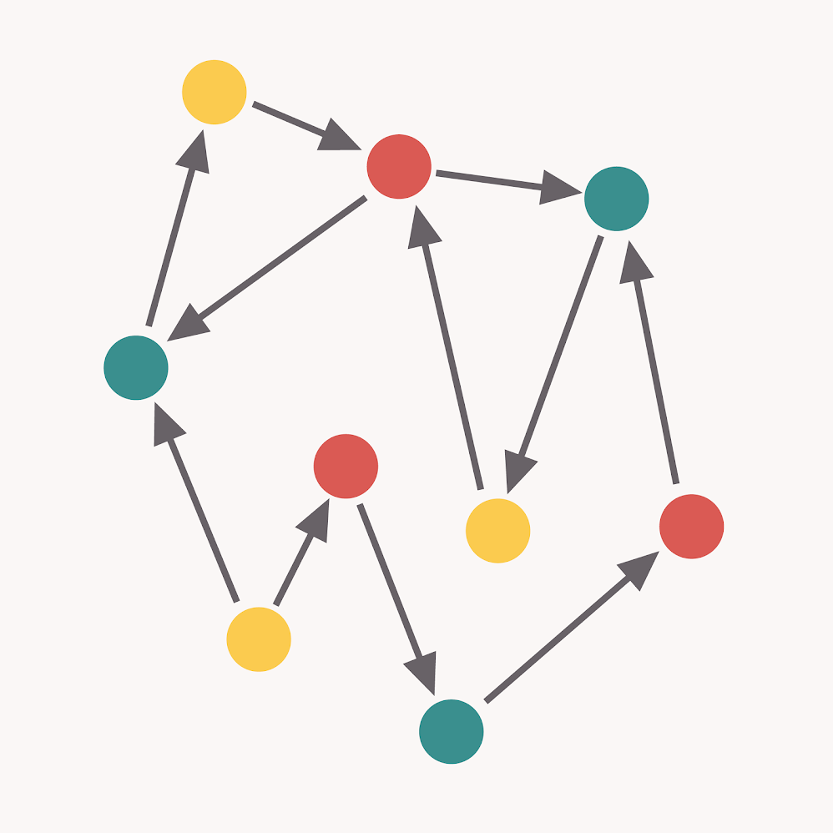
How to write good Code
Test driven development
Seperation of responsibilities
Separate decision to take an action from doing the action
Modules should have low coupling and high cohesion
low coupling & high cohesion
high coupling & high cohesion
high coupling & low cohesion
low coupling & low cohesion

Slide 12
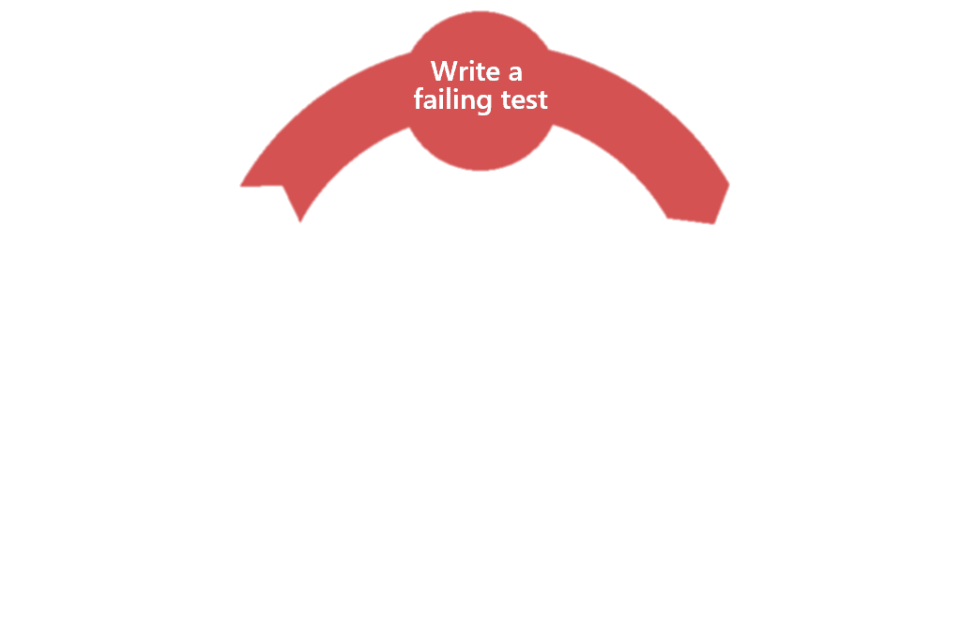
Red Phase
Test driven development
Write test
Define API and behavior
Test must fail

Slide 13

Green Phase
Test driven development
Make test run successful
Do not care at all about clean code
Do not use patterns or rules like DRY
Write most minimal code the get the test green
Developers tend to either over engineer or stay in analysis paralysis.

Slide 14

Refactor Phase
Test driven development
Kent Beck said: „remove duplicates“
Rule of three
Think about usefull patterns and abstractions
Do not write new tests (remember to only write new tests for new requirements)

Slide 15
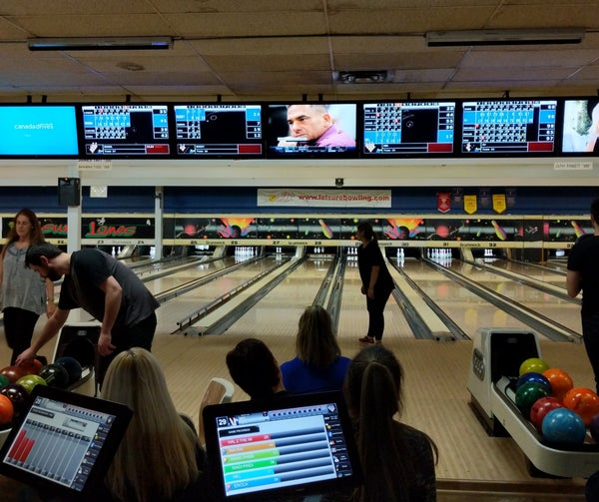
What are we gona develop today?
Coding case
We will try to develop the business rules of an automatic scorer for Bowling.
We develop it in a series of mini “sprints”
We strictly follow the TDD workflow
Collect cases where we had problems
Discuss our experiences after each sprint

Slide 16
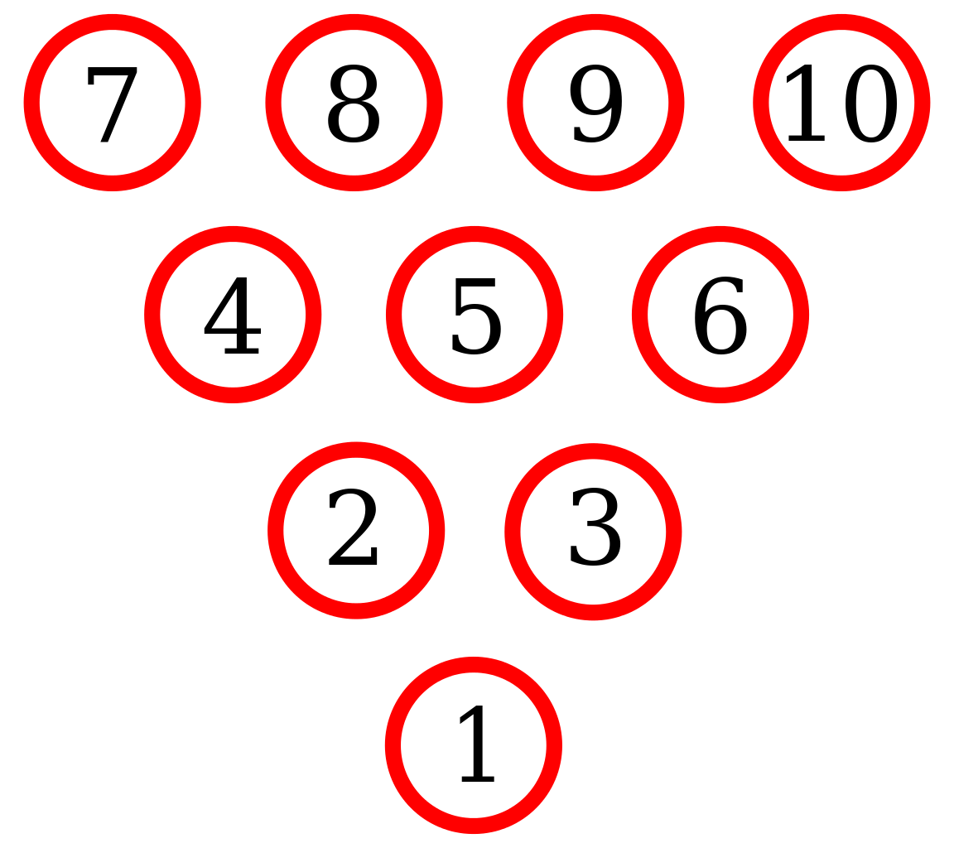
Bowling basic rules
Coding case
Bowling is played with 10 pins
Each player plays for 10 frames
A player has two throws per frame to knock down all pins

Slide 17
Sprint 1
Coding case
All ten pins are standing in the beginning of a frame
Knocked down pins are counted towards the players score
The same pin can not be counted twice in the same frame
It is possible to query the currently standing pins
It is possible to query the score of the player

Slide 18
Sprint 2
Coding case
A game can be started for multiple players.
It is the turn of the next player after a player finishes a frame.
The game is over after each player finished their tenth frame.
After the game ends the player scores are submitted to the global highscore board.
All frames of all players can be accessed.

Slide 19
Sprint 3
Coding case
It is the turn of the next player after a strike.
The two following throws after a strike a counted twice
The following throw after a spare is counted twice
Throwing a strike in the 10th frame results in two extra throws
Throwing a spare in the 10th frame results in one extra throw

Slide 20
Sprint 4
Coding case
An animation service can be called to identify special pin patterns
An animation service can be called to identify special game events
…

